Slide 1
Self reliant vertical garden with controllable web application

Slide 2
Experiment sample

Slide 3
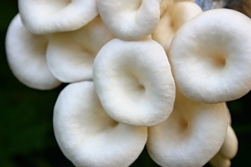
Experiment Sample
Mushroom: - Short Life span
Need Specific Environment to grow (28 c/ 80% humidity)

Slide 4
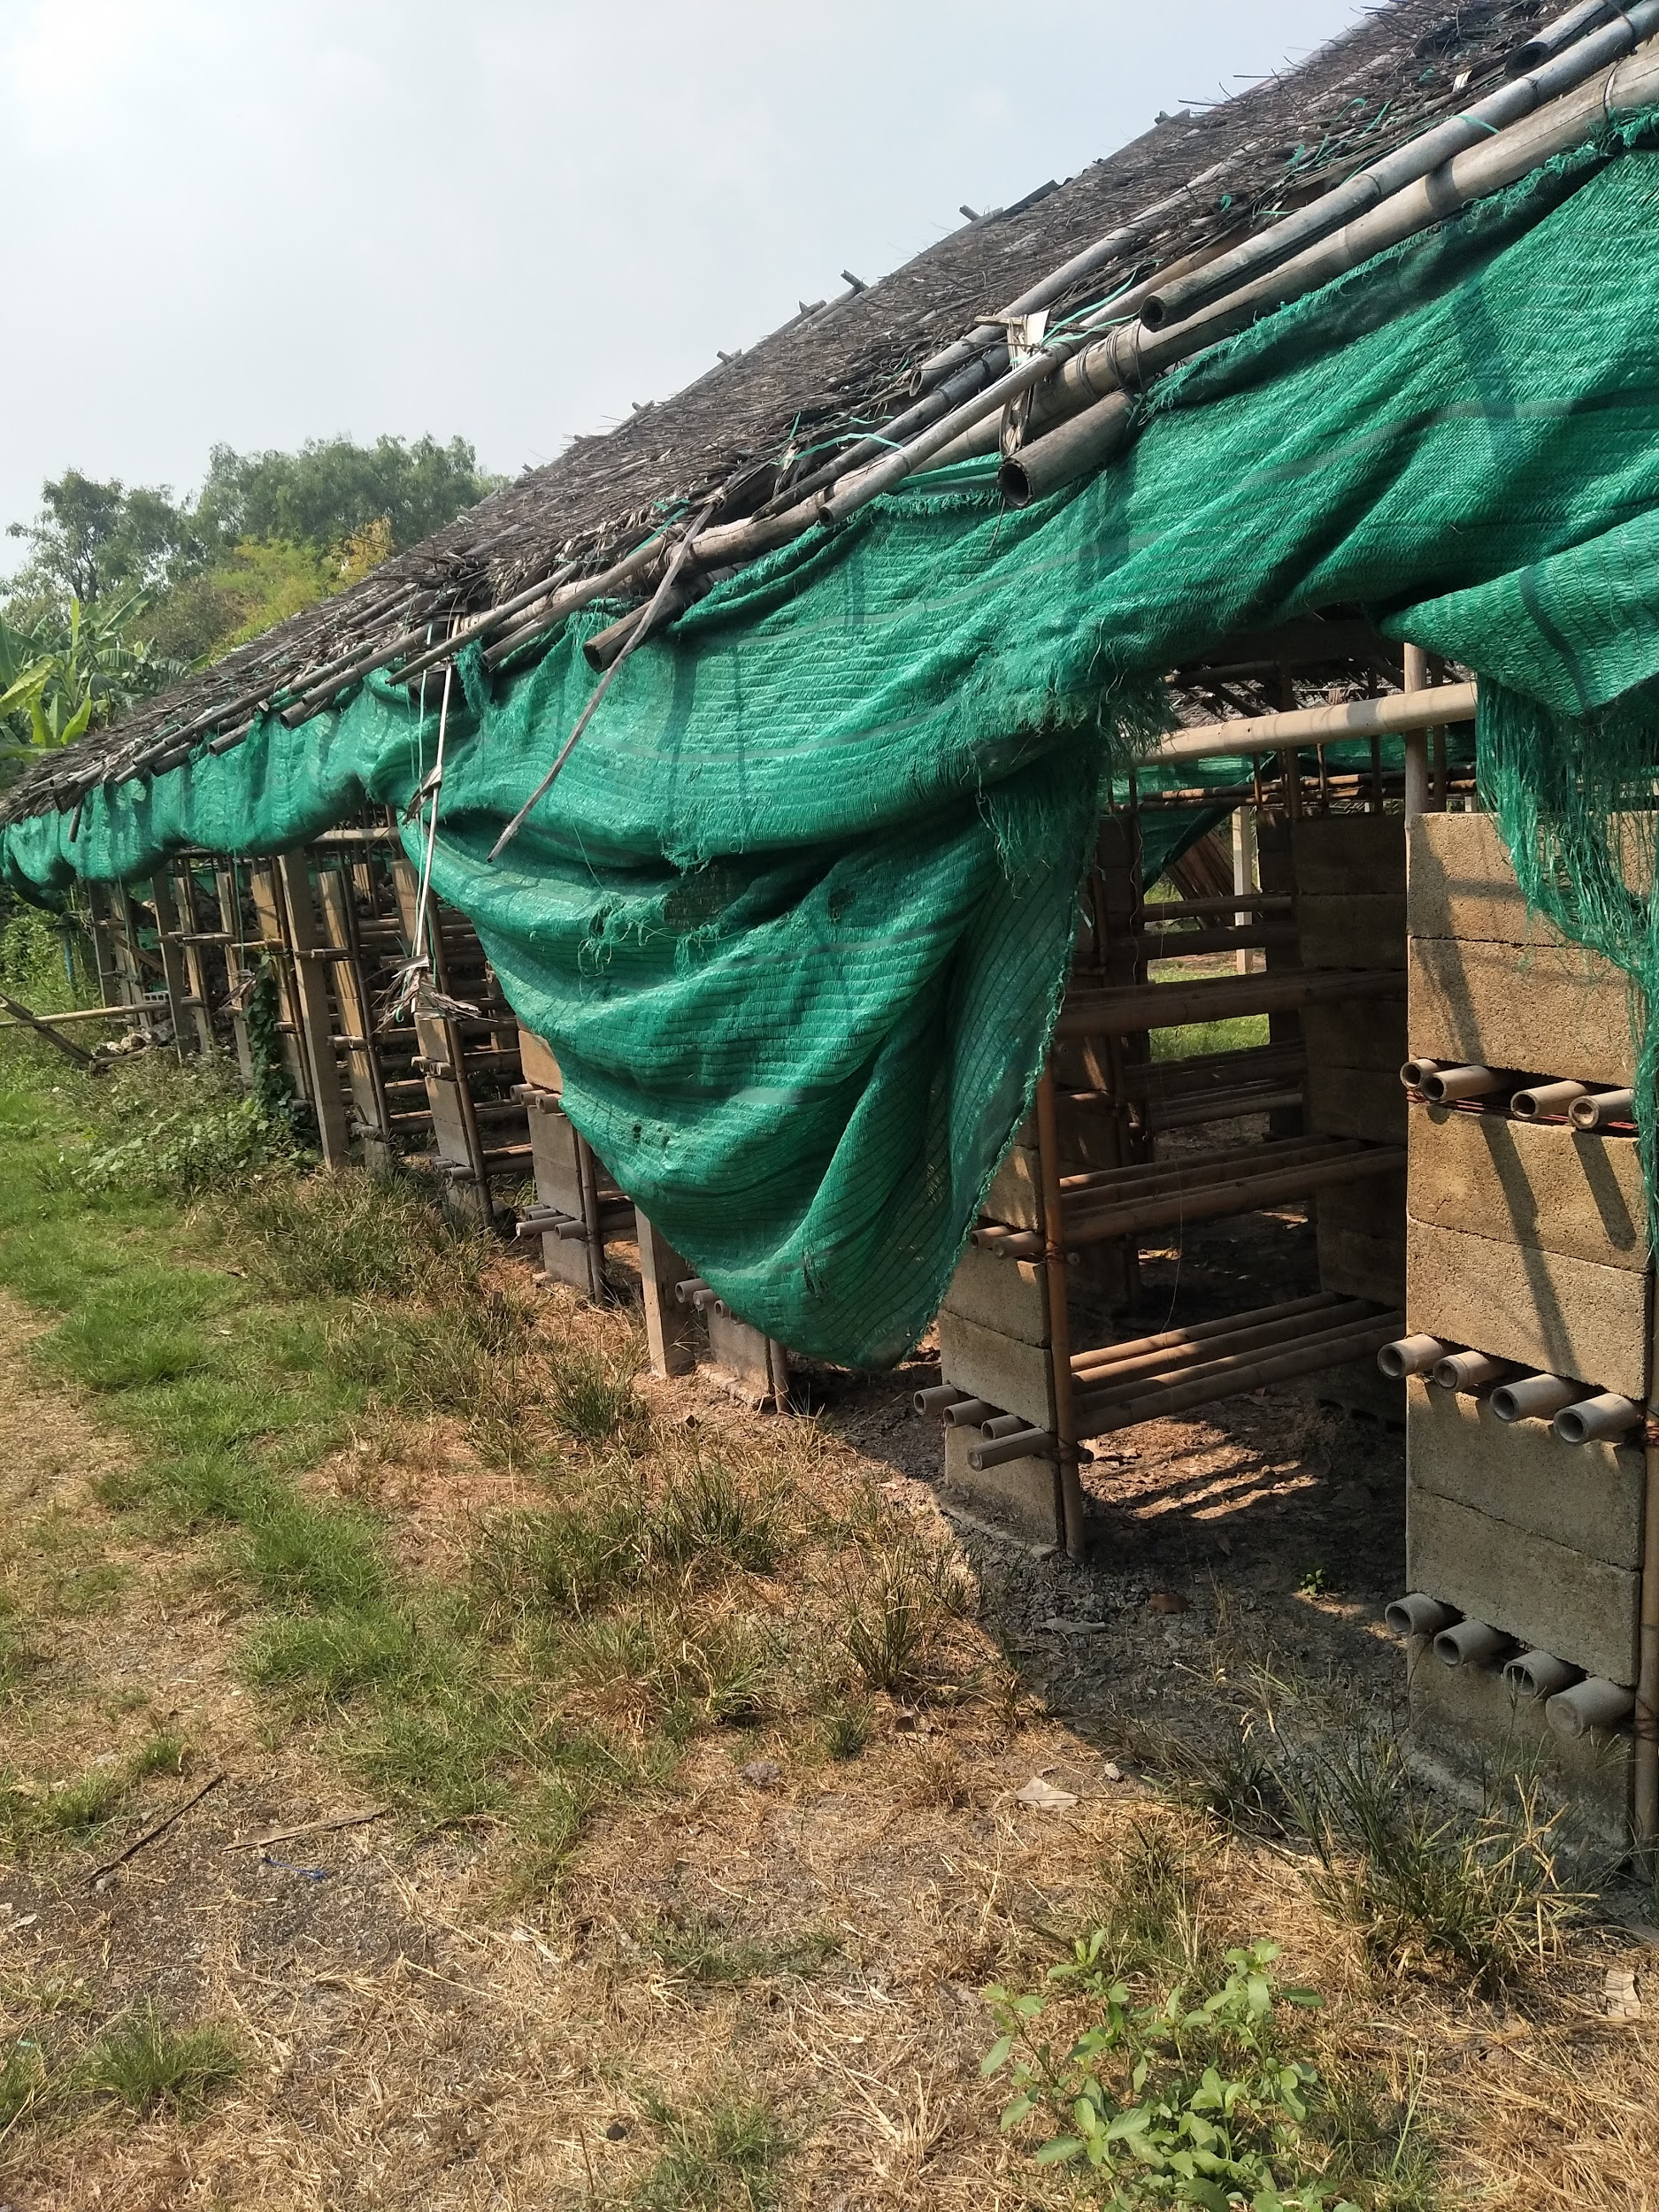
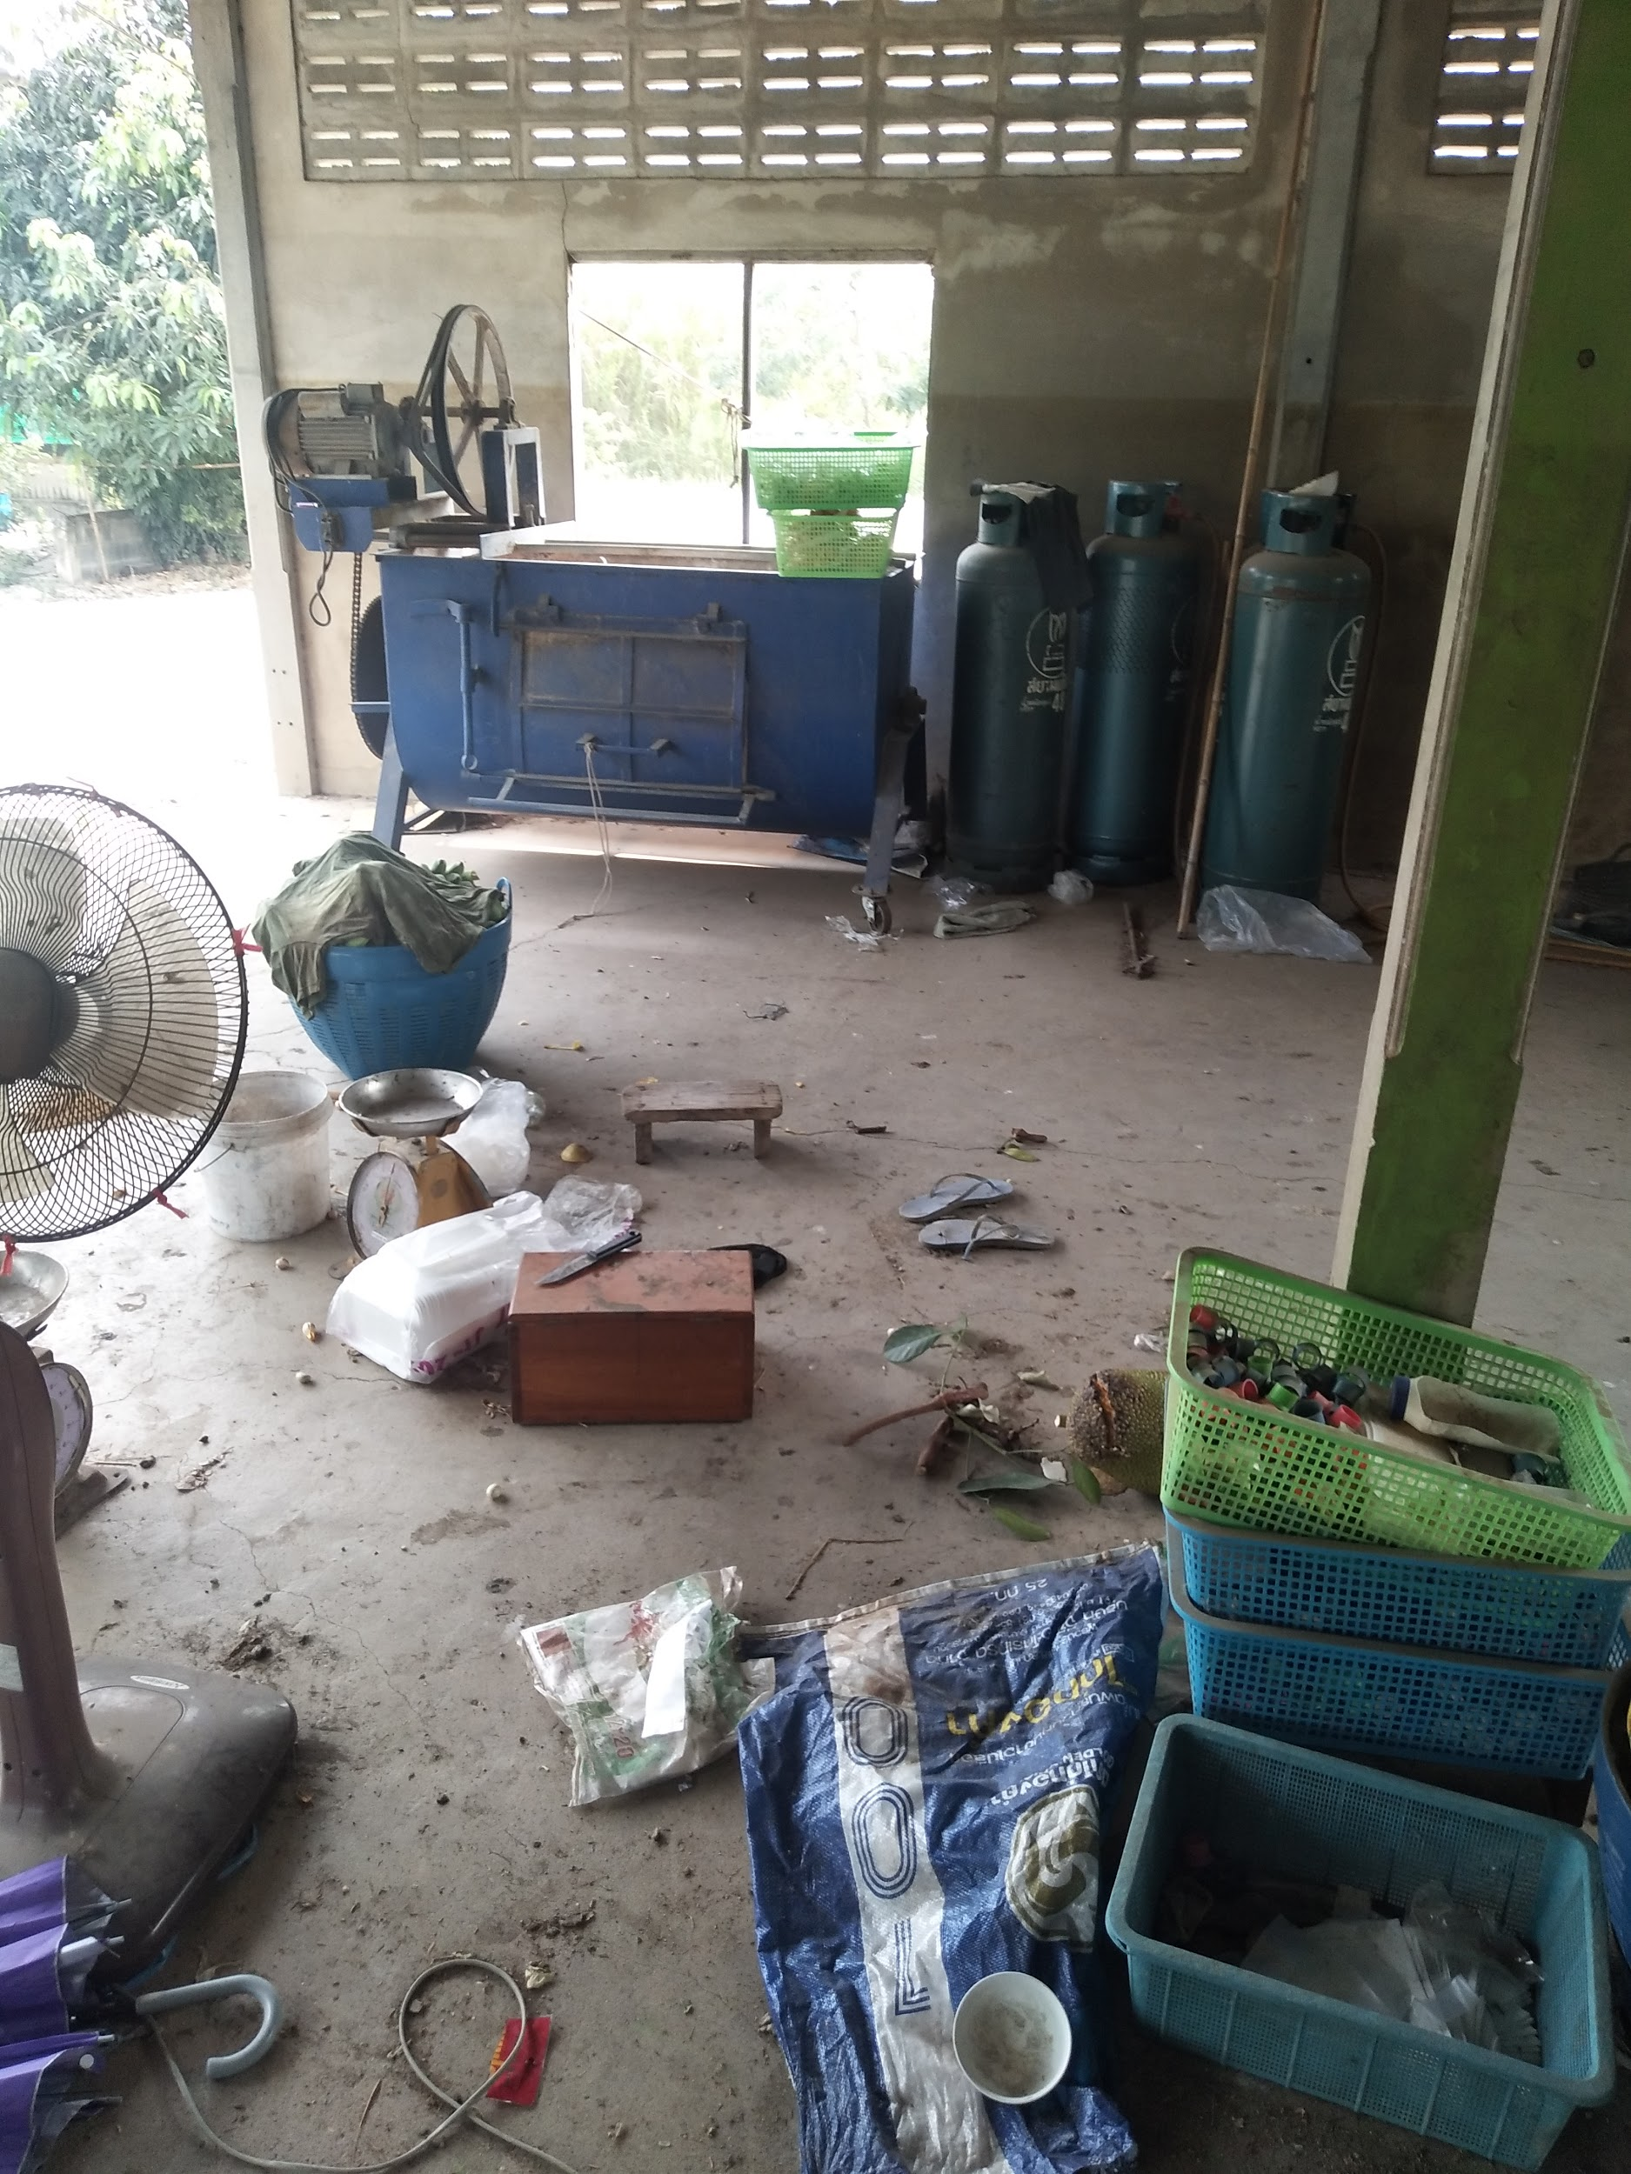
Experiment Sample
Information gather: Mushroom farm in Pathumthani
Factors: Humidity, Temperature

Slide 5
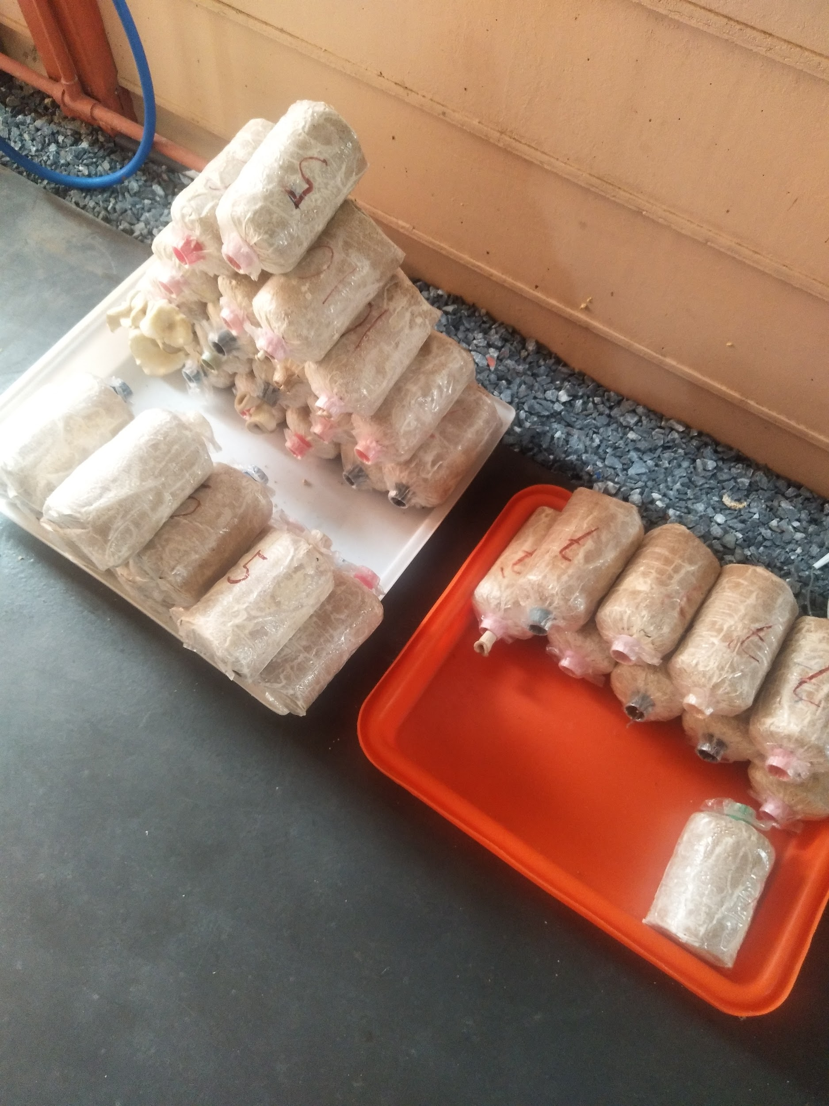
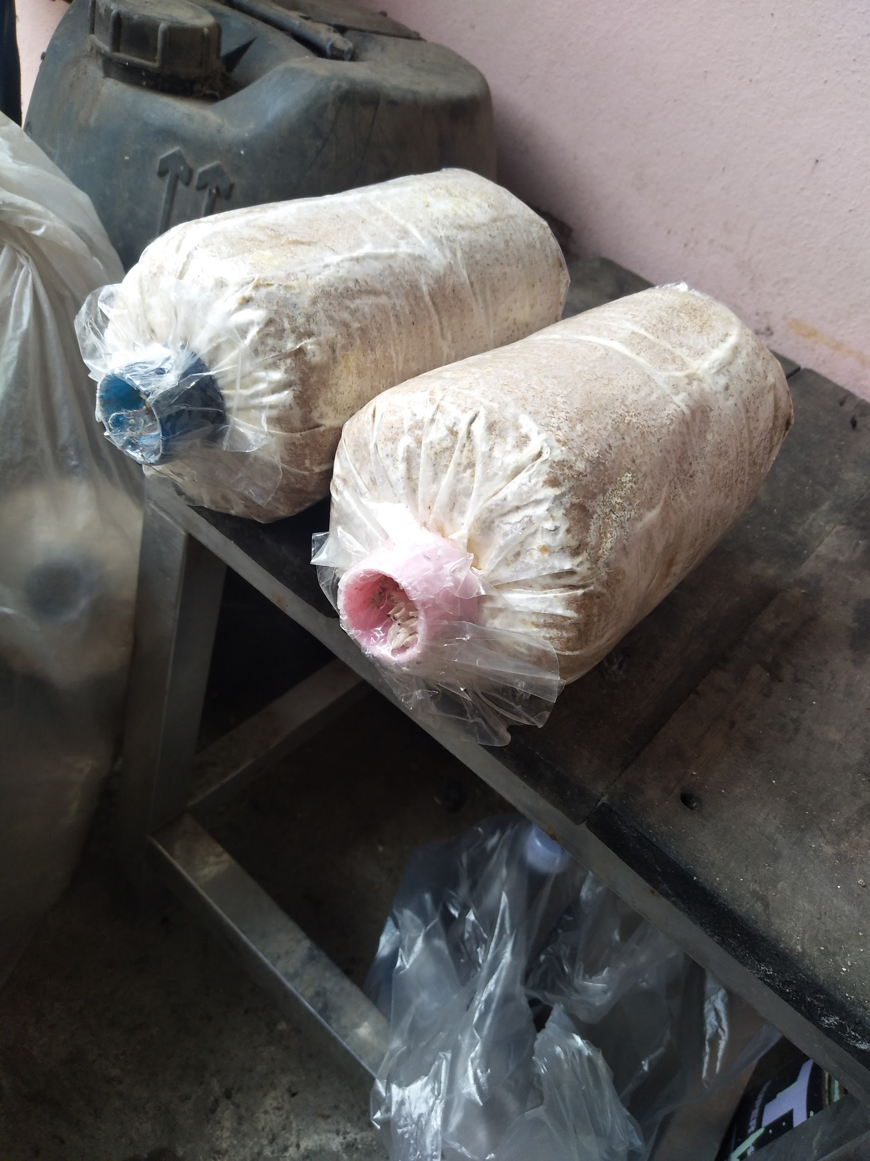
Experiment Sample
Information gather: Mushroom farm in Pathumthani

Slide 6
Hardware aspects

Slide 7
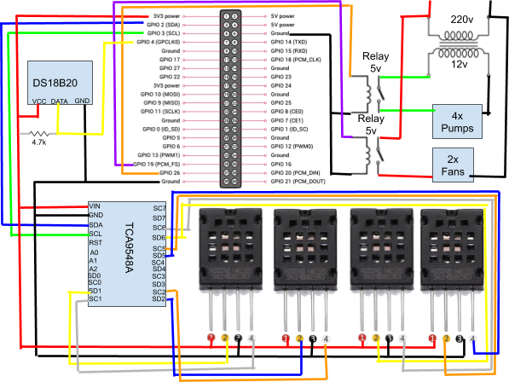

Slide 8
Model
Control System:
Temperature (℃) | Humidity(%) | Ventilators | Pump
Less than 28* | Less than 80* | Not working | Working
Less than 28 | More than 80 | Working | Not working
More than 28 | Less than 80 | Working | Working
More than 28 | More than 80 | Working | Not working

Slide 9
Mechanical aspects

Slide 10
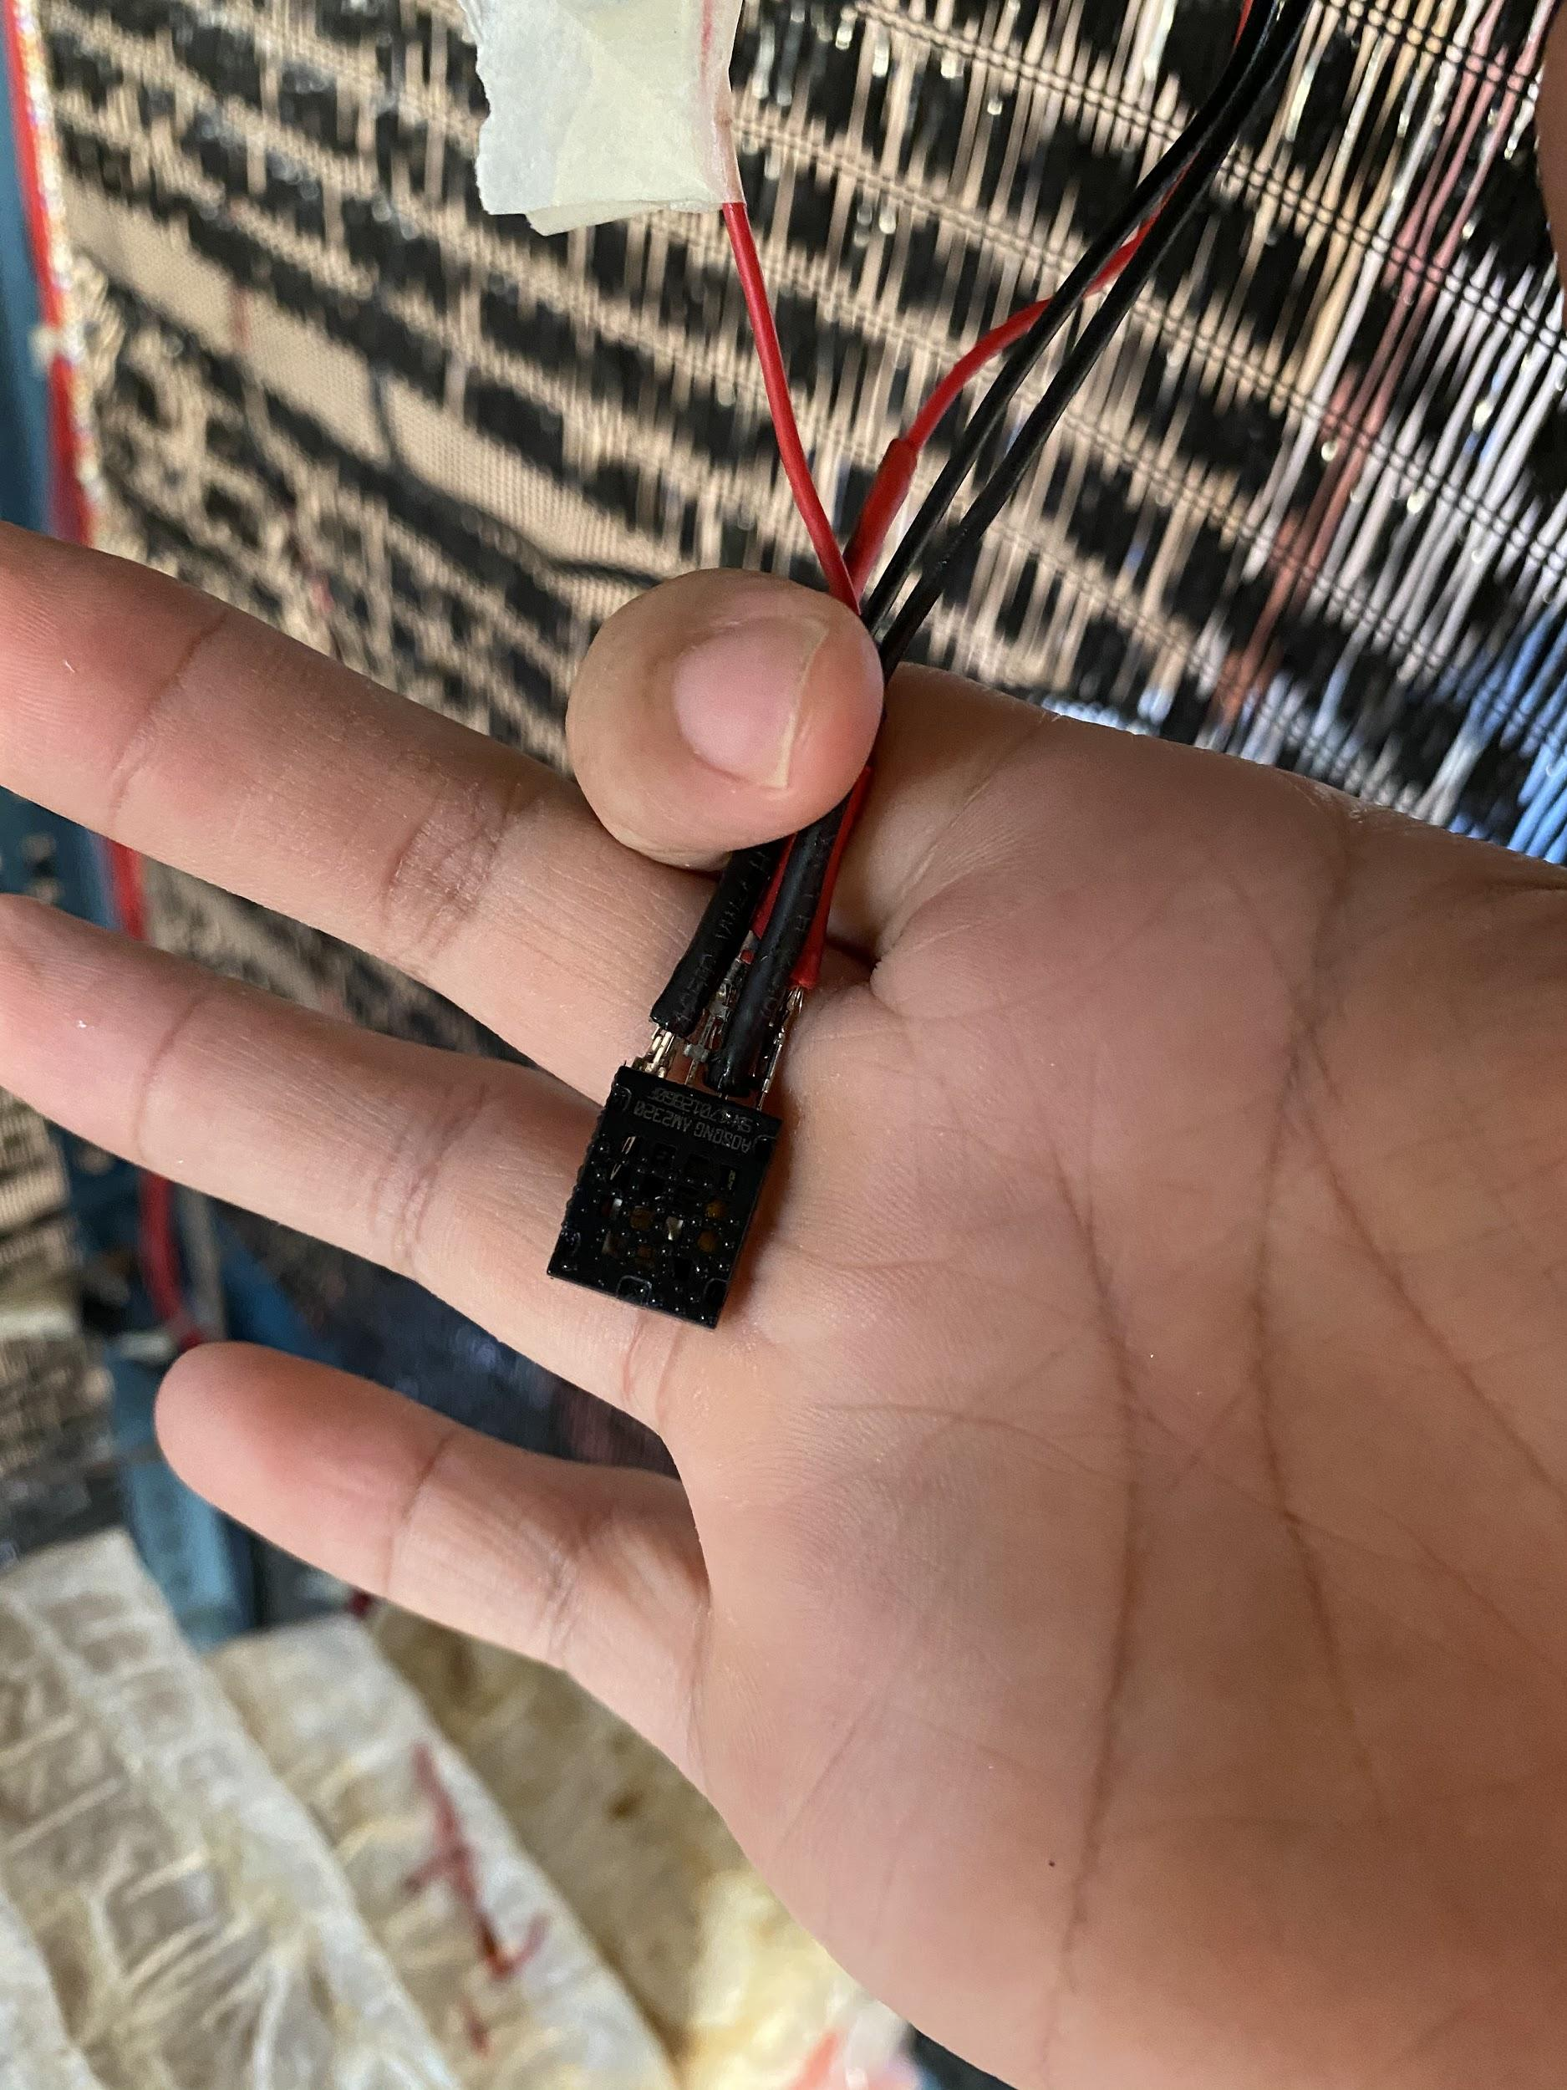
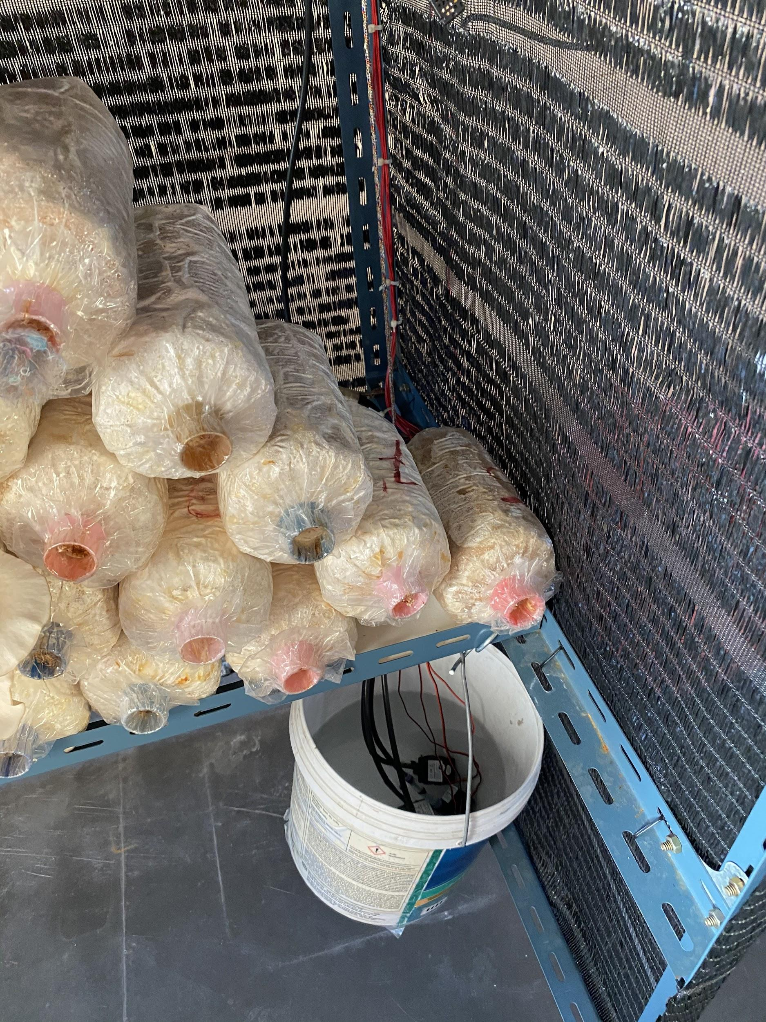

Slide 11
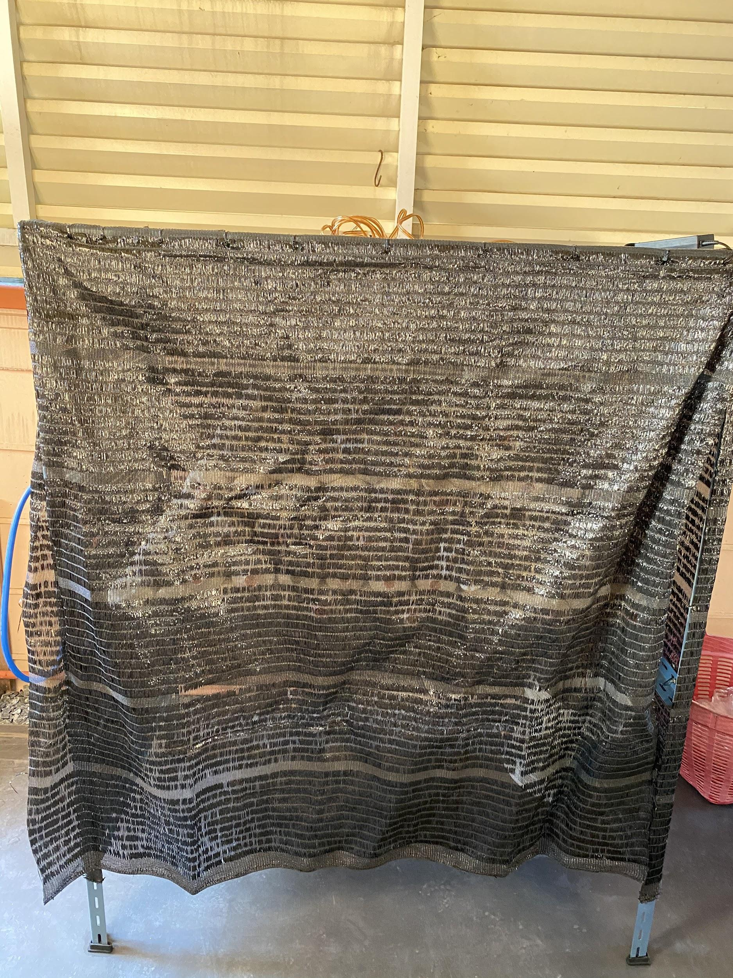
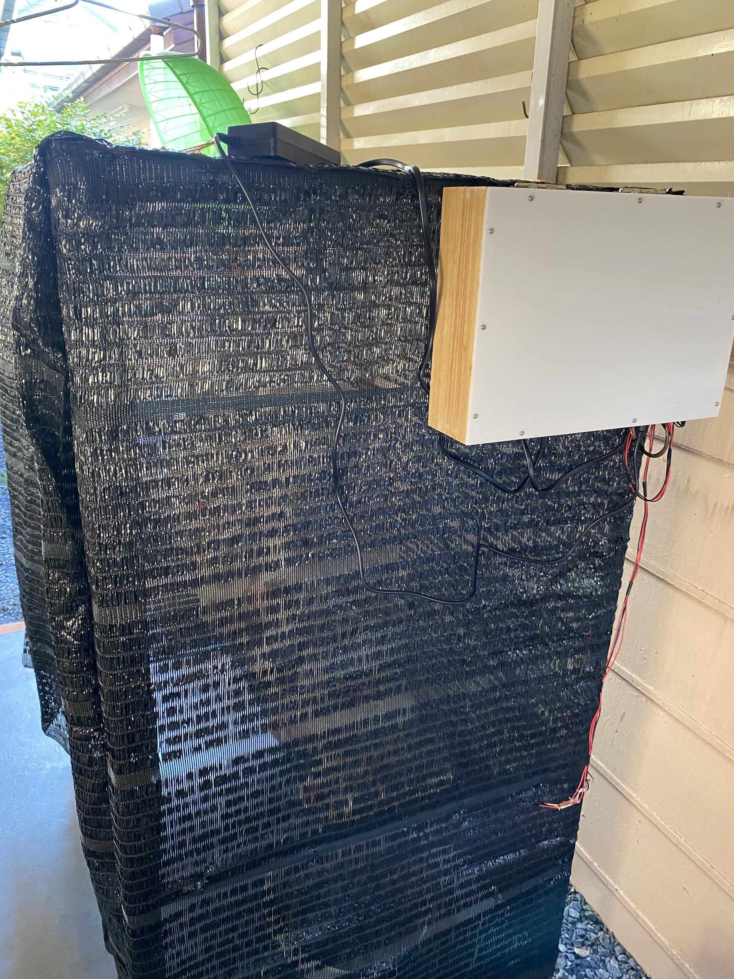

Slide 12
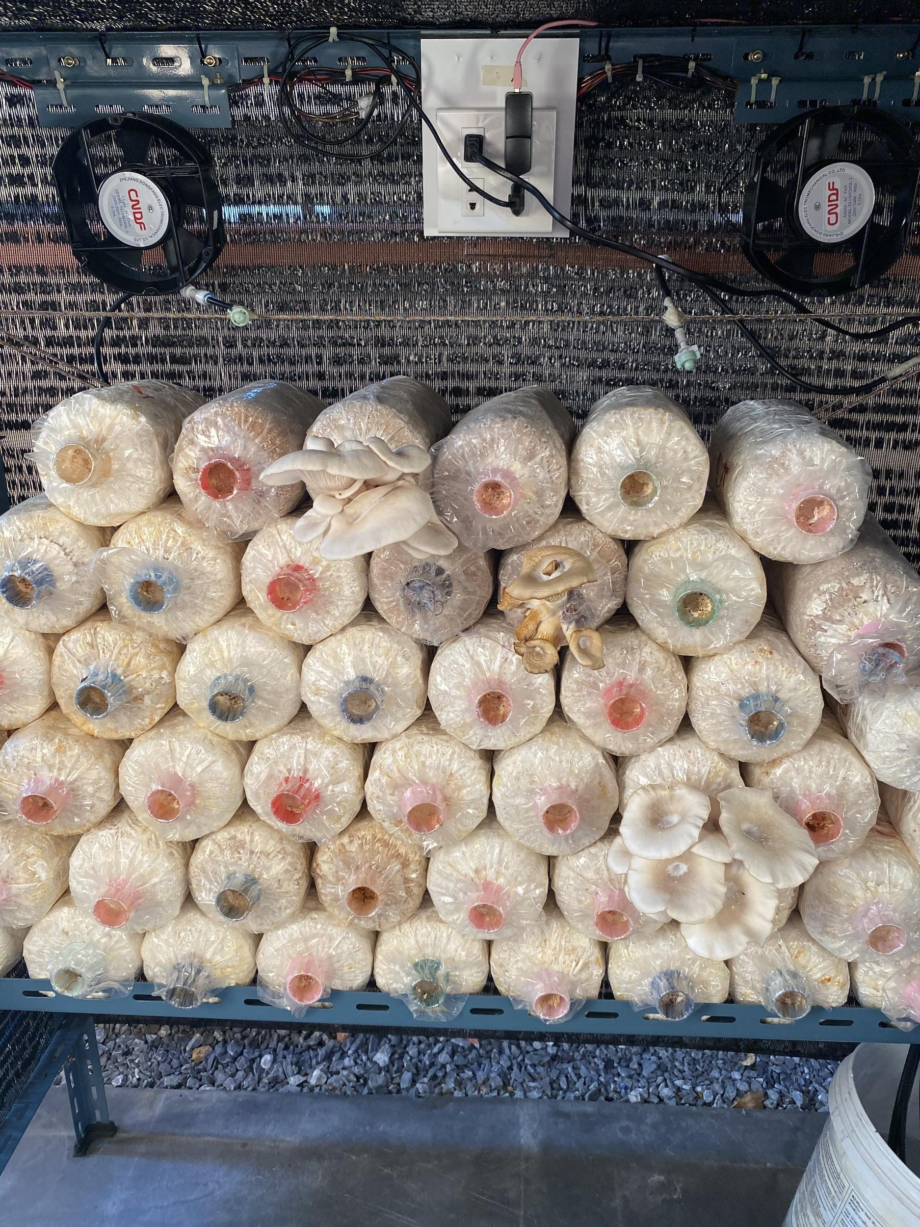
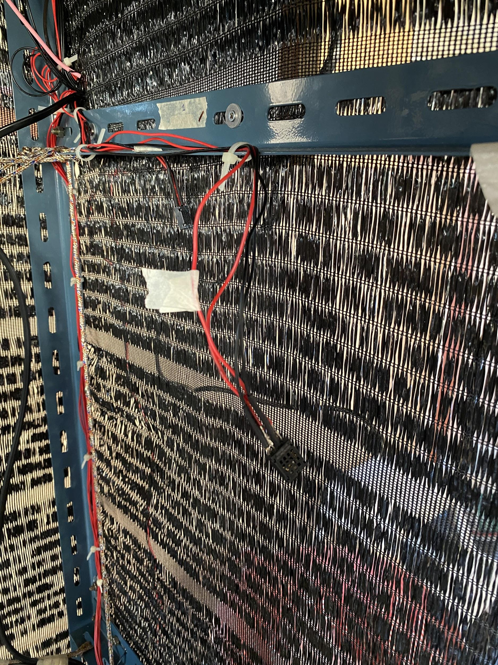

Slide 13
Conclusion
Substitution human works.
Better quality control.

Slide 14
Thank you

